Slide 1

6th Grade Accelerated Math
Unit 7, Lesson 6 Area of Composite Figures Volume 1, pg. 326

Slide 2


Benchmark
MA.6.GR.2.2
Solve mathematical and real-world problems involving the area of quadrilaterals and composite figures by decomposing them into triangles or rectangles.
volume 1, pg. 326

Slide 3
Integrated Mathematical Thinking and Reasoning Standards
MA.K12.MTR.1.1 Actively participate in effortful learning both individually and collectively.
MA.K12.MTR.2.1 Demonstrate understanding by representing problems in multiple ways.
MA.K12.MTR.3.1 Complete tasks with mathematical fluency.
MA.K12.MTR.4.1 Engage in discussions that reflect on the mathematical thinking of self and others.
MA.K12.MTR.5.1 Use patterns and structure to help understand and connect mathematical concepts.
volume 1, pg. 326

Slide 4

Learning Target
I can find the area of composite figures.
I can find the value of a missing dimension for a quadrilateral or a composite figure.
volume 1, pg. 326

Slide 5

Warm-Up
volume 1, pg. 326

Slide 6
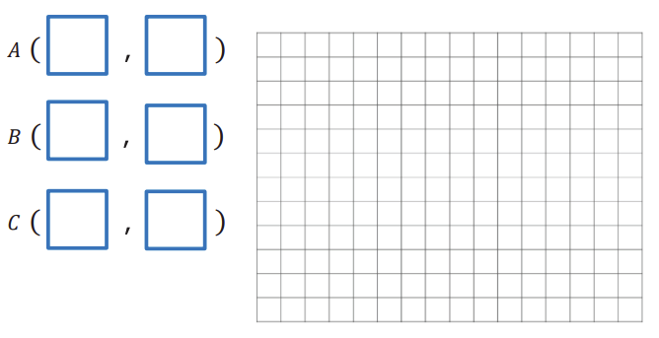
7.6.1 Warm-Up: Closest to Six
1. Use the digits 0 to 9, at most one time each, to fill in ordered pairs for all three points, such that the area of Triangle 𝐴BC is closest to 6 square units.
volume 1, pg. 326

Slide 7

Guided Instruction
volume 1, pg. 327

Slide 8
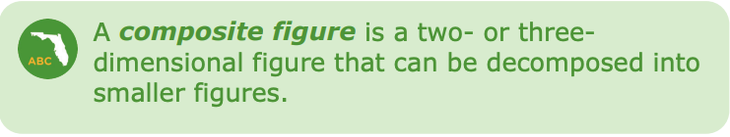
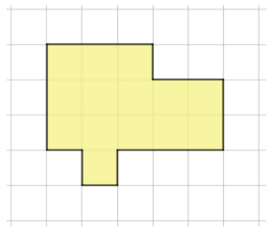
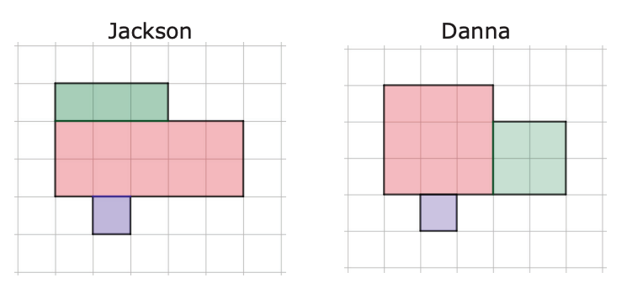
7.6.2 Guided Instruction: Area of Composite Figures
Jackson and Danna were instructed to find the area of the composite figure below. The length of each square is 1 centimeter (cm).
Both Jackson and Danna decomposed the figure, but their teacher noticed they each decomposed it differently.
volume 1, pg. 327

Slide 9
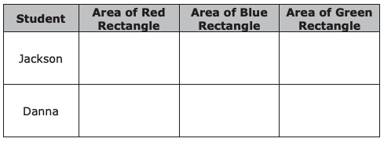
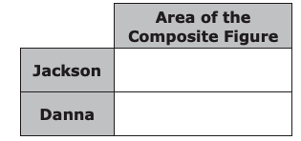
Complete the table about each student’s work. Include units.
To find the area of the composite figure, find the sum of the areas of the rectangles for each student. Include units.
volume 1, pg. 327

Slide 10

3. Explain why both students got the same area of the composite shape.
volume 1, pg. 327

Slide 11

Guided Practice
volume 1, pg. 328

Slide 12

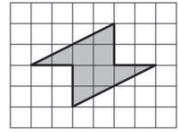
7.6.3 Guided Practice: Area of Composite Figures
A composite shape is shown. The length of each square is 1 inch (in).
Draw lines to decompose the figure into rectangles and/or triangles.
Find the area of each rectangle and/or triangle. Include units.
volume 1, pg. 328

Slide 13
c. Find the sum of the areas of the rectangles and/or triangles to find the area of the composite figure. Include units.
d. Find a classmate who decomposed the shape differently than you did. Describe their process.
volume 1, pg. 328

Slide 14
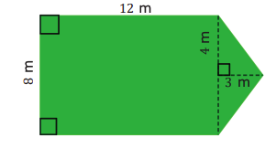
2. Thomas has decided to put grass sod in his backyard. A drawing of his backyard is shown.
How much sod does Thomas need to buy?
volume 1, pg. 328

Slide 15

Collaboration
volume 1, pg. 329

Slide 16

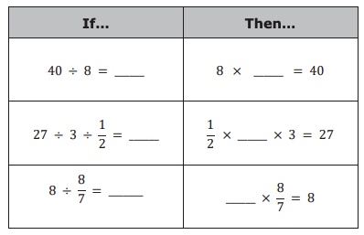
7.6.4 Collaboration: Finding a Missing Value
1. Complete the table by filling in the blanks for the following math facts.
volume 1, pg. 329

Slide 17
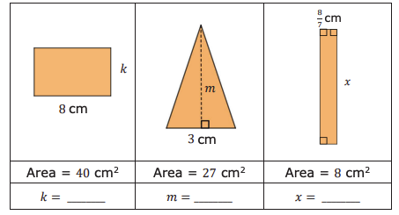
2. With your partner, use the previous math facts to find the missing dimensions of the quadrilaterals. All measurements are in centimeters (cm).
volume 1, pg. 329

Slide 18
Guided Practice
volume 1, pg. 329

Slide 19
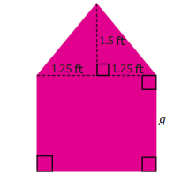
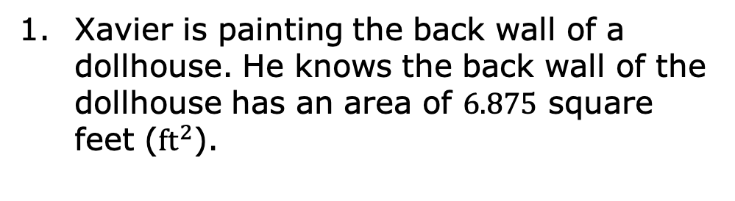
7.6.5 Guided Practice: Finding the Value of the Missing Dimension
Xavier is painting the back wall of a dollhouse. He knows the back wall of the dollhouse has an area of 6.875 square feet (${ft}^{2}$).
What is the area of the triangular top? Include units.
What is the area of the rectangular base? Include units.
What is the height, 𝑔, of the rectangular base? Include units.
volume 1, pg. 329

Slide 20
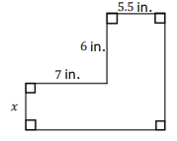
2. The area of the composite figure is 84 square inches (${in}^{2}$). Find the missing dimension. Include units.
volume 1, pg. 330

Slide 21

Your Turn
volume 1, pg. 330

Slide 22
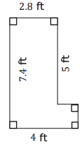
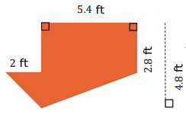

7.6.6 Your Turn!
For each composite figure, find the area, in square feet (${ft}^{2}$). Show your work.
1.
2.
Area = _______________
Area = _______________
volume 1, pg. 330

Slide 23
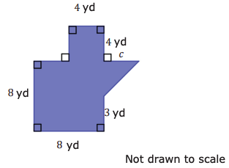
3. The area of the composite figure is 87.5 square yards (${yd}^{2}$). Find the value of the missing dimension. Include units.
volume 1, pg. 331

Slide 24

Wrap-Up
volume 1, pg. 331

Slide 25
7.6.7 Wrap-Up: Reflection
Complete each statement based about today’s lesson.
I am still unsure about …
____________________________________________ ____________________________________________ ____________________________________________
One question I still have about today’s lesson is …
____________________________________________ ____________________________________________ ____________________________________________
volume 1, pg. 331

